Slide 1
Digital Portfolio
STUDENT NAME: Dyuksha R
REGISTER NO AND NMID: 2422j0118 And asbruaz2422j0118
DEPARTMENT: BCA
COLLEGE: KPR College Of Arts Science And Research Bharathiyar University

Slide 2
PROJECT TITLE
Web Development Portfolio using HTML, CSS, and JavaScript

Slide 3


AGENDA
Problem Statement
Project Overview
End Users
Tools and Technologies
Portfolio design and Layout
Features and Functionality
Results and Screenshots
Conclusion
Github Link
3/21/2024 Annual Review

Slide 4

PROBLEM STATEMENT
Many students and developers lack a structured way to showcase their skills and projects. Traditional resumes fail to highlight interactive and visual aspects of one’s work. Hence, there is a need for a digital portfolio that can present skills, projects, and achievements in an engaging way.

Slide 5

PROJECT OVERVIEW
The project is a personal portfolio website developed using HTML, CSS, and JavaScript. It showcases personal details, skills, projects, and contact information in a responsive and user-friendly layout. It is designed to serve as an online resume and project showcase for web developers.

Slide 6

WHO ARE THE END USERS?
Students and graduates seeking internships or jobs Recruiters and hiring managers Freelancers showcasing their services Clients looking for web developers

Slide 7

TOOLS AND TECHNIQUES
HTML5 → Structure of the website. CSS3 → Styling, animations, responsive design. JavaScript → Interactivity (form submission alert). VS Code → Code editor. GitHub Pages → Free hosting for making portfolio live.

Slide 8
POTFOLIO DESIGN AND LAYOUT
Simple, colorful, and user-friendly layout. Animated gradient background for modern look. Navigation bar for smooth movement between sections. Rounded profile photo, skill badges, and project cards with hover effects.
8

Slide 9
FEATURES AND FUNCTIONALITY
About Me section to introduce myself. Skills section to showcase programming knowledge. Projects section with sample works. Contact Form for easy communication. Responsive design with attractive animations.

Slide 10
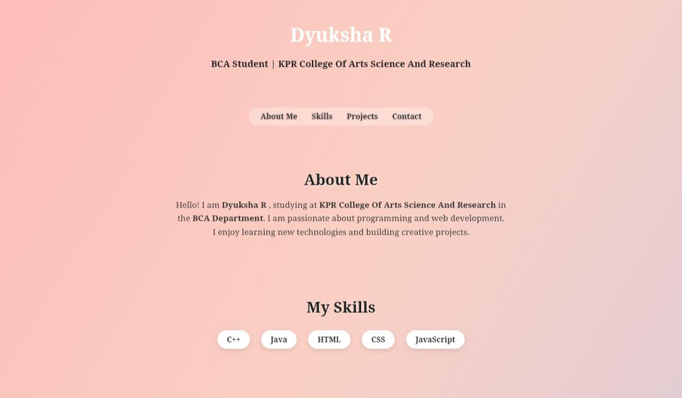

RESULTS AND SCREENSHOTS
3/21/2024 Annual Review
10

Slide 11
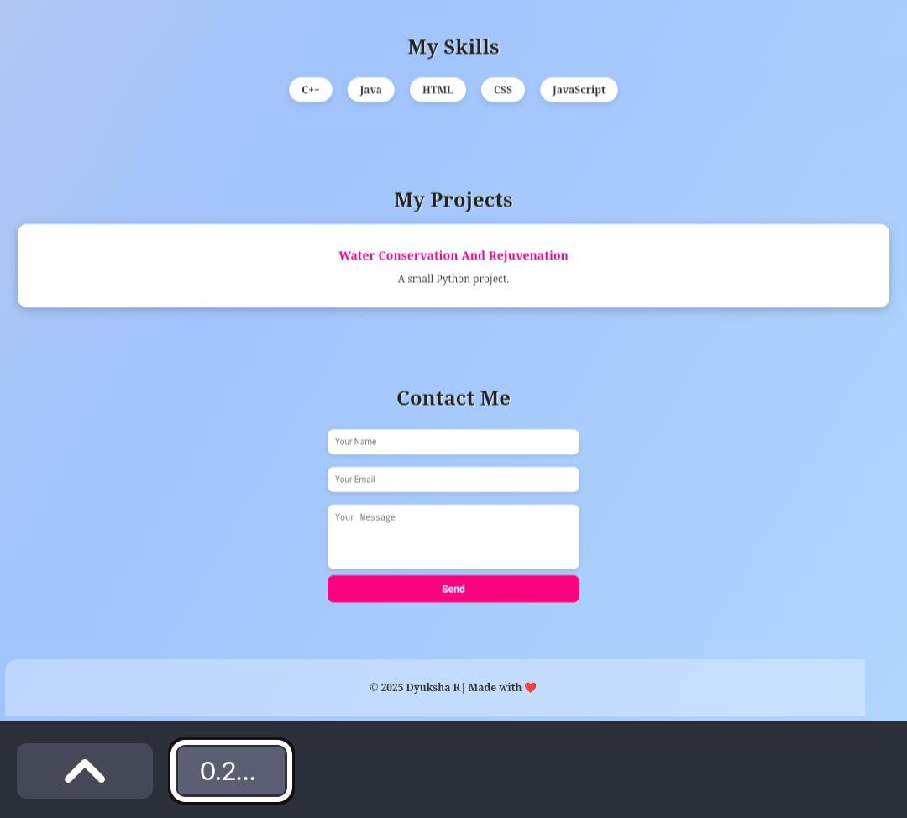
RESULTS AND SCREENSHOTS
3/21/2024 Annual Review
11

Slide 12
GITHUB LINK
https://github.com/dyuksharaja/KPR25.git
12

Slide 13
CONCLUSION
This personal portfolio website highlights my skills, projects, and academic background in a professional and colorful way. It acts as my digital identity, making it easy for others to know about me and contact me.
13

